Slide 1
Injury Illness Prevention Program

Slide 2
Worker Fatalities in California
Pipefitter and Welder - died after falling through a fiberglass light panel while making repairs to a rooftop cooling system.
Tree Worker - died after falling while trimming a tree in Willow Creek for the tree service business he started with his wife in 2016.
A 29 year old employee was helping load the I-beams onto a trailer bed when co-worker was utilizing a forklift. The falling I-beams fatally struck employee and was knocked to the ground. (San Diego)

Slide 3
Regulations
Who
Why
Title 8, California Code of Regulations Section 3203(T8 CCR 3203)
Injury/Illness Prevention Program (IIPP)
Every California Employer must have a written program.
A copy must be maintained at each worksite.
Employees must be informed of the IIPP.
When
How
What
Where
Notes:
Every CA employer must establish, implement and maintain a written IIPP and a copy must be maintained at each worksite or at a central worksite if the employer has non-fixed worksites such as Physical Plant Operations. The requirements for establishing, implementing and maintaining an effective written IIPP are contained in Title 8 of the California Code of Regulations, Section 3203.
Each employee must be aware of the IIPP. This can be accomplished through training, email correspondence, bulletins and other means of communication.

Slide 4
Did You Know
422 Workplace Fatalities Fatalities
In California there were 376 workplace fatalities in 2016 & 2017 and in 422 2018
In the US, 5190 workers were killed on the job in in 2016 & 5147 in 2017 and 5250 in 2018
US Bureau of Labor Statistics
Notes:
San Diego County: 19 Fatalities in 2016. That’s lowest since at least 2005
OSHA making a difference
In four decades, OSHA and our state partners, coupled with the efforts of employers, safety and health professionals, unions and advocates, have had a dramatic effect on workplace safety.
Since 1970, workplace fatalities have been reduced by more than 65 percent and occupational injury and illness rates have declined by 67 percent. At the same time, U.S. employment has almost doubled.

Slide 5
Injury Cost to the District
The cost for 2017 & 2018 is the total payments made & includes injuries that may have occurred in previous years and are still open cases that will keep accruing.
Injury cost in 2017
1430 injury cases
$$15,266,679.00
Injury cost in 2018
1815 injury cases
$$16,389,461.13
Notes:
In addition to these direct costs, employers incur a variety of other costs that may be hidden or less obvious when an employee is injured or ill, but in most cases involve real expenditures of budget or time. These expenditures are commonly referred to as indirect costs and can include:
Any wages paid to injured workers for absences not covered by workers' compensation;
The wage costs related to time lost through work stoppage;
Administrative time spent by supervisors following injuries;
Employee training and replacement costs;
Lost productivity related to new employee learning curves and accommodation of injured employees; and
Replacement costs of damaged material, machinery and property.

Slide 6
Incident VS. Accident
Incident
Accident
Is an unplanned, undesired event that adversely affects completion of a task
is an unplanned, undesired event that results in personal injury or property damage.
All accidents are Incidents

Slide 7
Safety Analogy
1
Serious Injury
29
Minor Injuries
300
None-Injury Accidents
3000
Hazards
For every
There Are
Notes:
One study found that for every single fatality there are at least 300,000 at-risk behaviors, defined as activities that are not consistent with safety programs, training and components on machinery. These behaviors may include bypassing safety components on machinery or eliminating a safety step in the production process that slows down the operator. With effective machine safeguarding and training, at-risk behaviors and near misses can be diminished. This also reduces the chance of the fatality occurring, since there is a lower frequency of at-risk behaviors.

Slide 8
Examples of Serious Injury, Minor Injury, Non-Injury & Hazard
Serious Injury
Minor Injury
Teacher hospitalized when they fall off ladder while hanging artwork causing broken bones
Employee missteps while descending step ladder and twist ankle
Notes:
To move from a reactive approach (after an occurrence) to a proactive approach (prevention) report all incidents. Address all incidents to control and prevent serious incidents.
Safety inspections also help improve safety performance proactively by eliminating or reducing hazards that contribute to injuries, illnesses and property damage.

Slide 9
Examples of Serious Injury, Minor Injury, Non-Injury & Hazard
Non-Injury Accident
Hazards
Employee leans to one side of ladder to hang art work & it starts to sway
Employee not placing ladder close enough to work area

Slide 10
How Does an Injury and Illness Prevention Program Work for You?
Established elements that focus on finding hazards in the workplace
Develop a plan for preventing and controlling those hazards
Management & employees working together are vital in identifying & addressing a safety hazard
You need to be trained about how the program works
NOT A SAFE ACT
Notes:
The program needs to be periodically evaluated to determine whether improvements need to be made

Slide 11
8 Program Elements
Responsibility
Compliance
Communication
Hazard Assessment
Accident & Exposure Investigation
Hazard Correction
Training
Record Keeping
Notes:
CA-OSHA will ask for these two things upon an investigation
Training & Instruction
Record Keeping
The code section requires that the written program consist of the above listed 8 elements.

Slide 12
Responsibility
Superintendent
Administrator
Employee
Safety Office
Overall Responsibility
Site Responsibility
Follow Safety & Health Codes/Regulations
Develop & Maintain Program
Notes:
The superintendent has overall responsibility, the Safety Office develops and maintains the program, administrators are responsible for their individual sites or programs, and employees are responsible for following safety & health codes and regulations as well as district policies and procedures.

Slide 13
Employee Compliance
Evaluations
Certificates of appreciation or presentations in front of peer groups recognizing safety acumen
Counseling
Evaluations
Classified employment regulations
Bargaining unit contract language
Notes:
Evaluations contain a section for rating employees knowledge of and adherence to safety policies. Awards can be in the form of memos, certificates and recognition at meetings.
Counseling should be conducted when an employee is observed using unsafe practices or violating procedures. If these actions continue or escalate a special evaluation may be deemed necessary.
The classified employment regulations, article VI, pertains to disciplinary actions, appeals, & hearings. Bargaining unit contract language regarding safety is in article 10 for classified employees, (PARA, OTBS, OSS) and in article 11 for SDEA.
NOTE: Please consult with human resources for questions pertaining to disciplinary procedures.

Slide 14
Communication
FORMAL & INFORMAL TRAINING
Ways to communicate safety
POSTINGS
You cannot be retaliated against for reporting hazards or potential hazards
WRITTEN DOCUMENTATION
STAFF MEETINGS
Notes:
Administrators and other supervisory employees are responsible for communicating with employees about occupational safety & health in a form readily understandable by all employees.
In addition, employees must be encouraged to inform administrators or other supervisory employees about workplace hazards without fear of reprisal and may be verbal or written as the employee chooses. Employees may use the Employee Report of Safety Hazard form and remain anonymous. The Employee Report of Safety Hazard form is available on the Safety Management website under “Forms & Labels.”

Slide 15
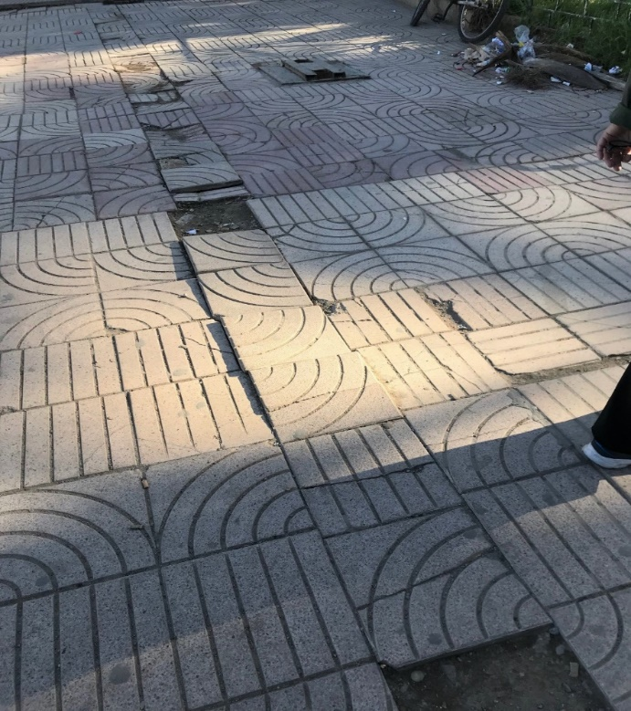
Hazard Assessment
Ways to assess a hazard
Semiannual Site Safety Inspection
Safety Data Sheets
Employee report of a safety hazard
What is wrong with these pictures?
Notes:
What’s wrong with these pictures? Picture on left – person only has 1 foot and turned sideways on ladder. Hi potential for ladder to tip and for employee to fall. Picture on right – Slip/trip/fall issue. A number of paver tiles are missing and/or buckling causing a trip/fall hazard.
Periodic inspections to identify and evaluate workplace hazards shall be performed by competent personnel, typically the BSS or POS. In addition there is an employee report of safety hazard form available on the Safety Management website.
Prior to introducing new products or chemicals forward a copy of the SDS to the Safety Office for review to ensure that there are no chemicals banned for use in schools and for evaluation on chemicals that have not been pre-approved for use. The review process will recommend to sites/Dept whether or not the product is allowed for use, banned from use or allowed with certain precautions.

Slide 16
Accident investigation
If you are in an accident or have an injury the district is required to fill out the following:
Form 78 – Supervisors report of injury/illness
Workers’ Compensation Claim Form (DWC-7) must be provided within twenty-four (24) hours of knowledge of any work-related injury or illness
Witness statements
If injured after normal business hours and you go to the hospital other than for first aid or observation then you must report the injury to the closest CA-OSHA office
Notes:
The above listed forms should be used to document any and all injuries or accidents.
If you are in an accident or have an injury the district is required to fill out the following:
Form 78 – Supervisors report of injury/illness
Workers’ Compensation Claim Form (DWC-7) must be provided within twenty-four (24) hours of knowledge of any work-related injury or illness
Witness statements
There is a guideline for basic rules for accident investigation that is part of district’s written IIPP and is available on the Safety Management website.
Workers' compensation law requires that the District immediately send to the State of California specific information electronically for every work-related injury/illness that results in lost time beyond the day of injury or requires medical treatment other than first aid, thus it is important to notify the Risk Management Dept. immediately when someone is injured.
If an injury occurs after normal business hours and you go to the hospital other than for first aid or observation then you must report the injury to the closest CA-OSHA office which is in San Diego within an 8 hour period or as soon as feasibly possible.

Slide 17
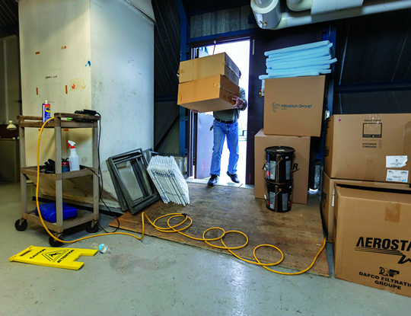
Correcting a hazard
Minor hazards may be corrected by site staff & some hazards require assistance from:
Physical Plant Operations
Safety Office
Outside Contractors, Vendors or Consultants
Can you see a problem?
Notes:
Hazard in the picture: see how many hazards you can find in the picture.
When hazards are identified they should be addressed immediately. If the hazard is beyond a sites means or ability to correct, steps should be taken to limit access to the hazard by use of barriers and warning signs. Contact Physical Plant Operations for assistance. Outside consultants and/or vendors may be required for some hazards requiring specialty certifications or equipment.

Slide 18
Training for you
If you are a new employee
Prior to new job assignments
When new substances, processes, procedures or equipment are introduced to the workplace
Whenever the employer is made aware of a new or previously unrecognized hazard
All workers on job specific hazards
Notes:
The Safety Office has training topic material available on the Safety Management website or we can send material via email and are able to assist you with your training requirements.
Site administrators or supervisors must provide training:
New Employees
Prior to new job assignment
When new substances, process, procedures or equipment are introduced to the workplace
All employee training must be documented, use sign-in sheets – Keep for 3 years

Slide 19
What training is required?
Injury Illness Prevention Program (IIPP)
Hazard Communication (HAZCOM)
Bloodborne Pathogen (BBP)
Fire Safety
There are other areas of safety that may be more specific for the area you work in and would be covered as a job specific type training

Slide 20
Recordkeeping
For Supervisors
Supervisor’s Report of Accident/Injury
Inspection Forms
Training
Accident Investigations
Employees
Remember you need to sign-in when receiving training
Notes:
The code requires that these documents be maintained at the site for 3 years. Ensure that prior to sending inspection forms to maintenance (PPO), you make a copy and keep it in a central location along with copies of the other records listed above.
NOTE: If your site is inspected by CA/OSHA you will be required to produce the documents and provide copies to the inspector.

Slide 21
For questions contact the Safety Office
858-627-7174
or
safetyoffice@sandi.net
or
Safety Management website
https://www.sandi.net/staff/safety-management/environmental-health-safety-office
Safety is about doing the right thing even if no one is looking because Safety starts with you!

